Slide 1
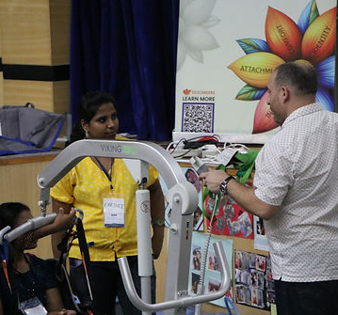

Welcome!
Developing and Maintaining a Learning Culture in Our Homes
Welcome
Notes:
Please change image

Slide 2


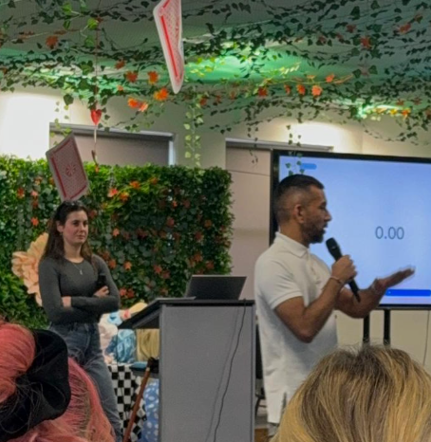

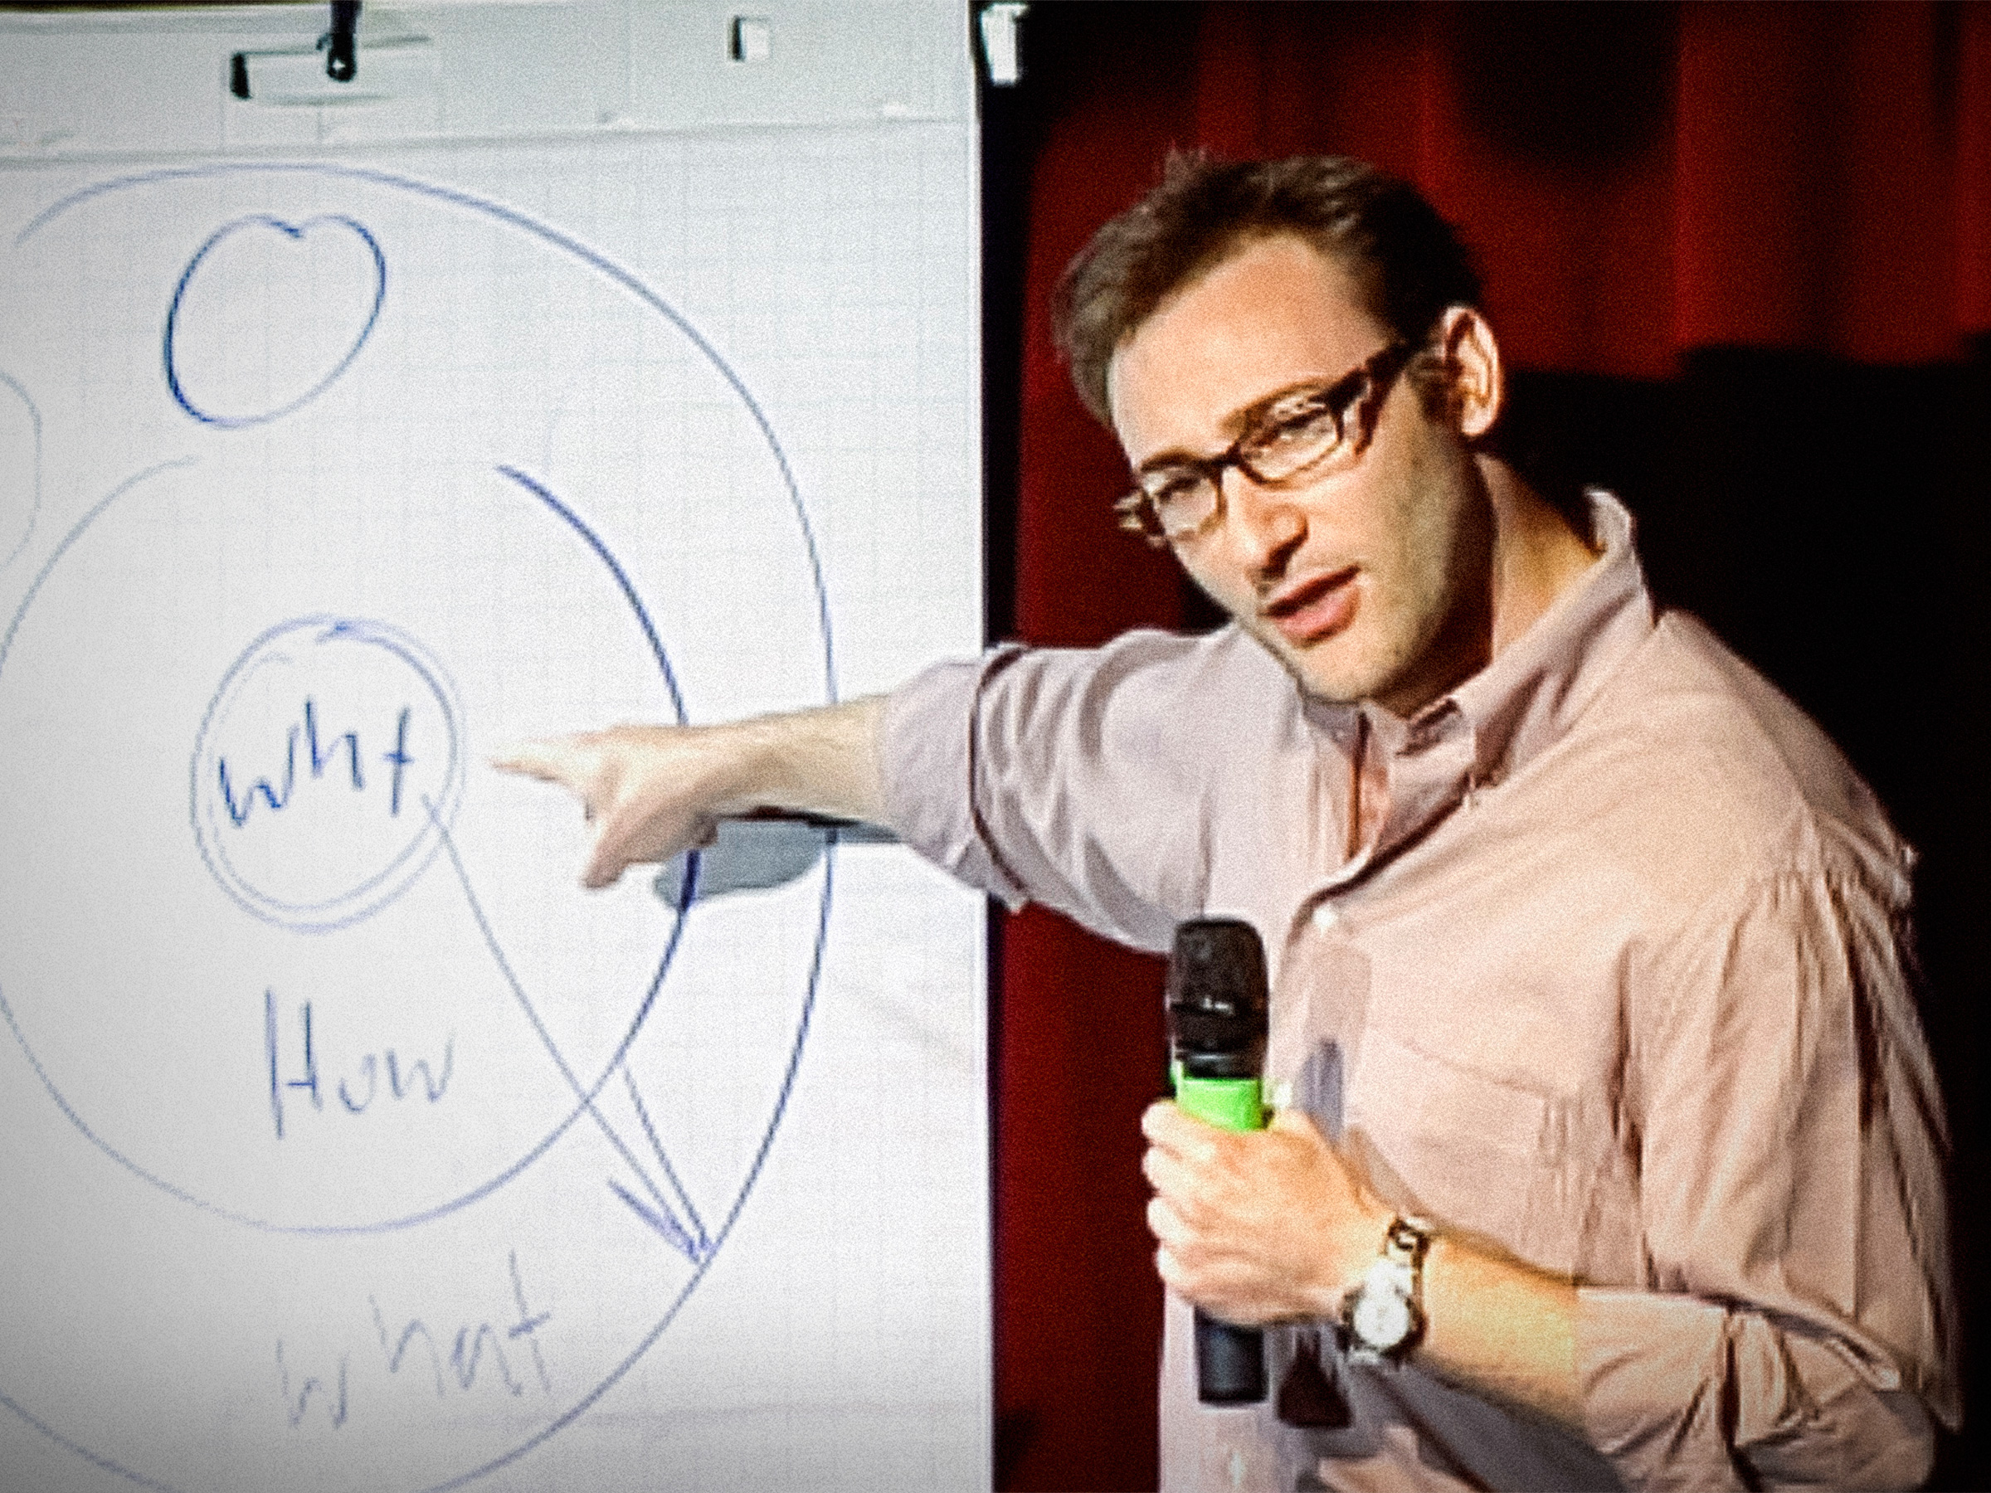

Slide 3


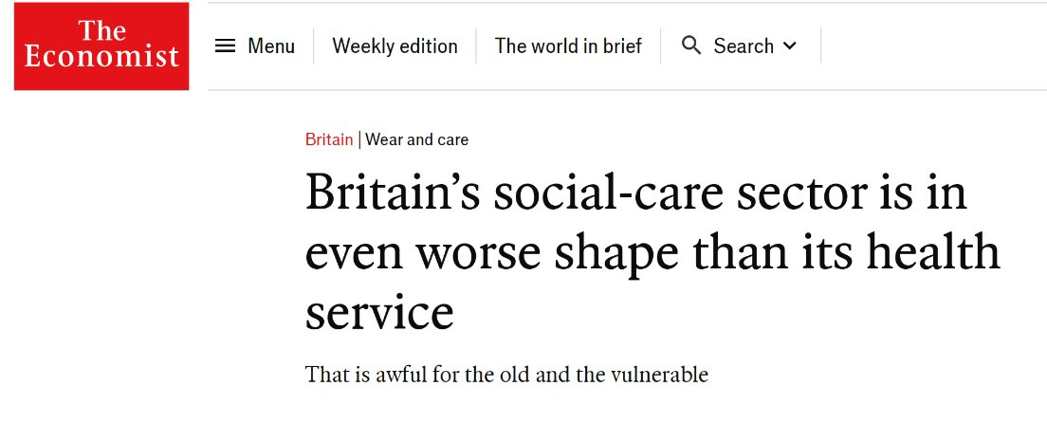
We all know the challenges facing the sector!​

Slide 4
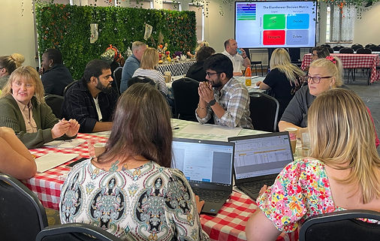


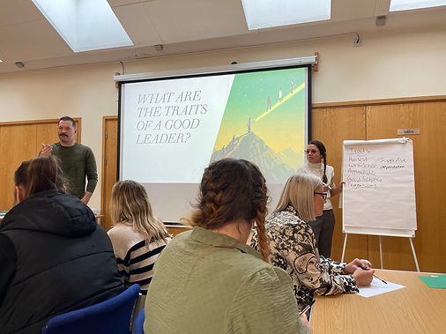

Investing in training and development:
the impact
Higher Employment Engagement
Retention Rates
Increased Productivity

Slide 5
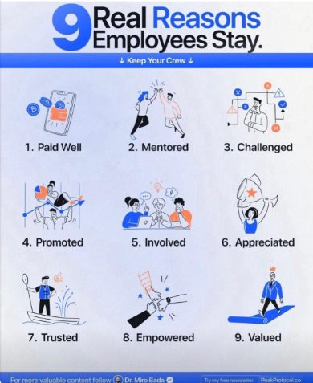
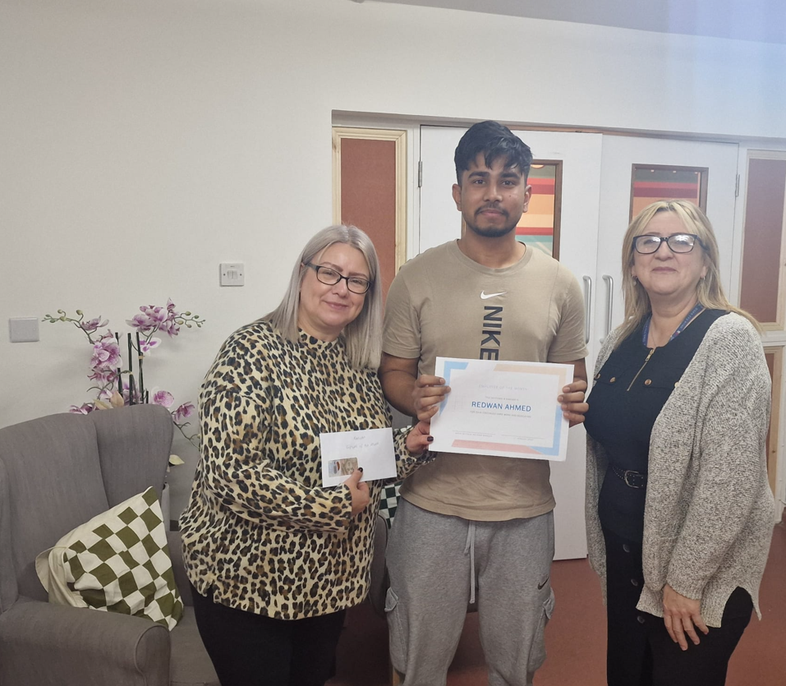

Slide 6
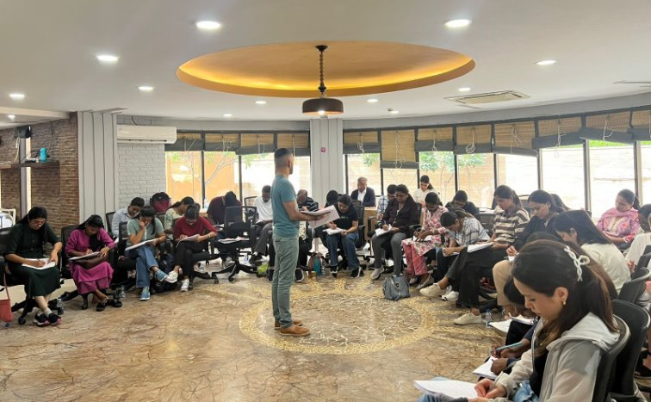
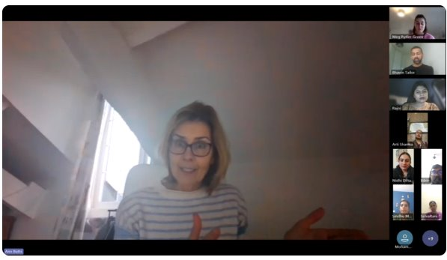
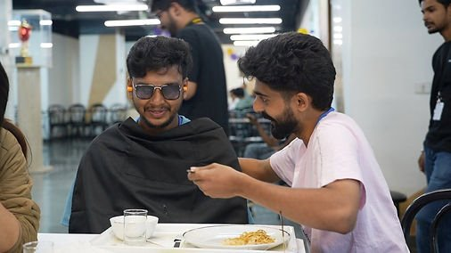
What We Offer:
Free E-Learning (on the 15 Care Certificate Standards)
English Language and Culture Course (4 weeks; online)
Social Care New-Entrant Course (8 weeks; online)
OSCE course
International Nurses Mentoring Group
Training and Development videos
Leadership Coaching

Slide 7

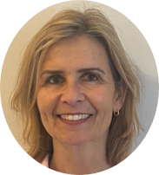


Who We Are:
BHAVIN TAILOR
DIRECTOR OF EDUCATION & PROGRAMMES
ANN BUTTS
NURSING AND CLINICAL CONSULTANT
MEAGHAN RYDER-GREEN
RESEARCH & DEVELOPMENT LEAD
ROSIE CULLUM
BUSINESS DEVELOPMENT
LEAD
Network of like-minded individuals who have excelled in their area of professional practice from across Health, Social Care and Education.​
Notes:
Bhav Meg / Ann / Rosie – phot of each and name/title

Slide 8
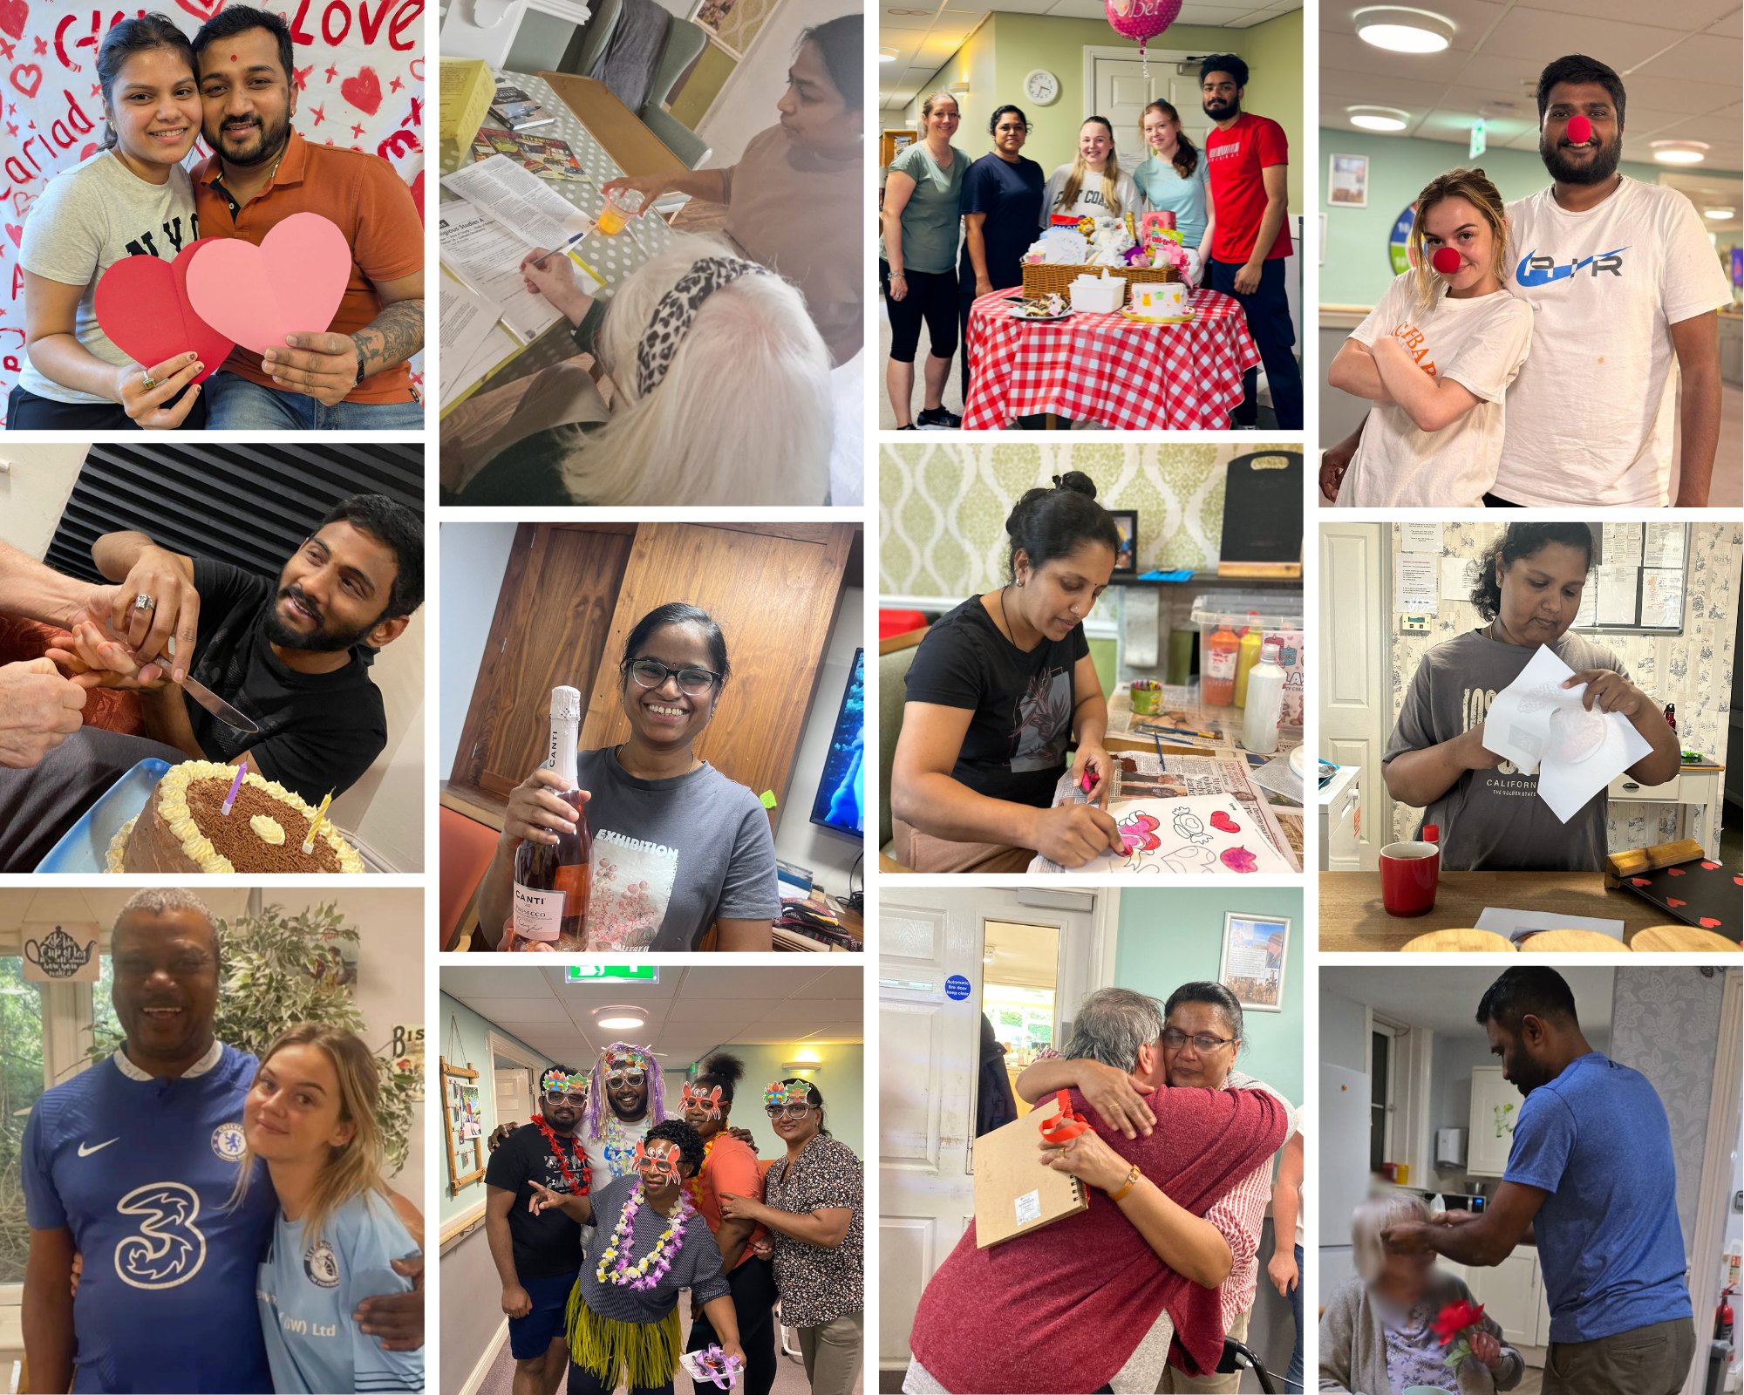
Thank you!
www.indagodevelopment.co.uk

